Slide 2
Building Your Own Face Recognition Service Using Amazon Rekognition
Vijayaraghavan Vashudevan

Slide 3








About me
Quality Automation Specialist at NatWest Group
Pynt.io Ambassador (API Security Testing tool)
Active Blogger (Dev. to and Medium platform), Mentor and YouTuber
Active Volunteer for AWS UG NCR Delhi, AWS UG MDU
vjraghavanv
LinkedIn @vjraghavanv

Slide 4

Agenda
Facial Recognition
Use cases for Facial Recognition
Amazon Rekognition: API Overview
Amazon Rekognition: Demo
Amazon Rekognition: Features
Q & A
References

Slide 5

Facial Recognition
Image Source: dribbble.com
Face Detection
Face Capture
Feature Extraction
Face Matching

Slide 6
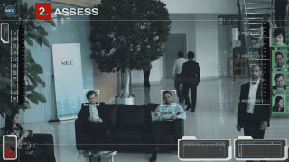

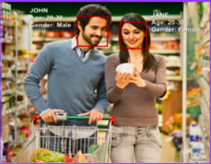
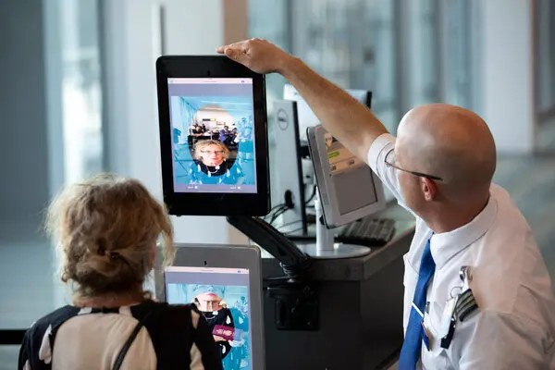
Use cases for Facial Recognition
Security
Identity Verification
People Counting
Image Source: Gifer.com
Image Source: engadget.com
Image Source: researchgate.net
Cataloging
Image Source: nytimes.com

Slide 7

Amazon Rekognition: API Overview
Easy to add images and video analysis to your application through simple API endpoints
Highly scalable, deep-learning Machine Learning algorithm developed by computer vision scientist

Slide 8
Amazon Rekognition: Features
Non-Storage API Operations
Detect-Labels
Detect
Faces
Detect
Moderation
Labels
Recognize
Celebrities
Compare
Faces
Detect-Text
Storage API Operations
IndexFaces
SearchFacesByImage
SearchFaces
ListFaces
DeleteFaces
Create
Collection

Slide 9
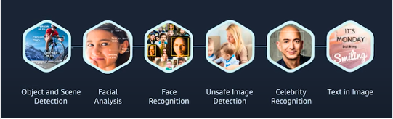


Amazon Rekognition: Features
Customers who are currently using Amazon Rekognition service

Slide 10
Demo - How to build your own facial recognition service using Amazon Rekognition

Slide 11
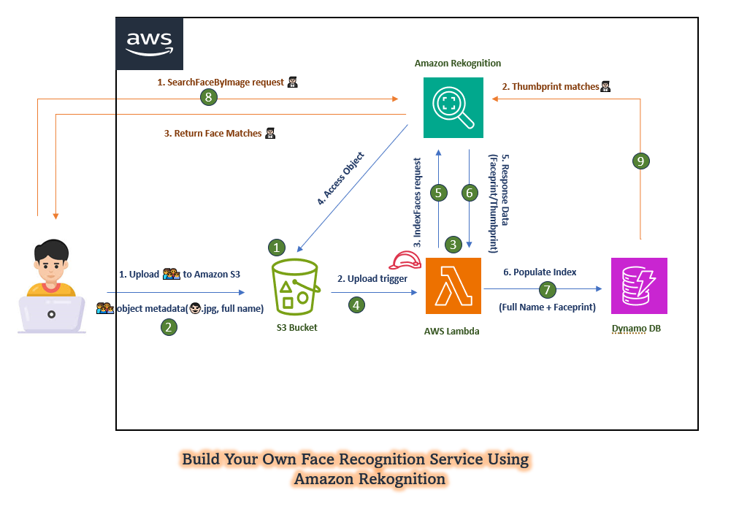

Slide 12







Amazon Rekognition
1. SearchFaceByImage request 🤵🏻
2. Thumbprint matches🤵🏻
3. Return Face Matches 🤵🏻
4. Access Object
5. Response Data
(Faceprint/Thumbprint)
3. IndexFaces request
1. Upload 👨‍👩‍👦‍👦 to Amazon S3
2. Upload trigger
6. Populate Index
👨‍👩‍👦‍👦 object metadata(👨🏻.jpg, full name)
(Full Name + Faceprint)
S3 Bucket
AWS Lambda
Dynamo DB
Build Your Own Face Recognition Service Using
Amazon Rekognition

Slide 13
References
https://aws.amazon.com/rekognition/
https://docs.aws.amazon.com/managedservices/latest/userguide/rekognition.html
https://aws.amazon.com/blogs/machine-learning/build-your-own-face-recognition-service-using-amazon-rekognition/
https://aws.amazon.com/rekognition/pricing/
https://medium.com/cloudnloud/build-your-own-face-recognition-service-using-amazon-rekognition-c75919d7f66e

Slide 14

Q&A
Connect with me
Image Source: stock.adobe.com
LinkedIn @vjraghavanv

Slide 15
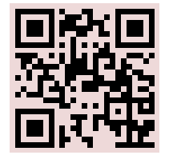
Building Your Own Face Recognition Service Using Amazon Rekognition
THANK YOU!
Feedback
Vijayaraghavan Vashudevan
Quality Automation Specialist, NatWest Group
https://forms.gle/QYmVpcMvBKQBJk6k7

Slide 16







Gold Partner
Silver Partner

